Slide 1

Session 2: Let's build a Robot and SLAM(no pun) it
Introduction to URDF
Build a robot model in URDF format
Keyboard control of the robot
SLAM on a robot

Slide 2
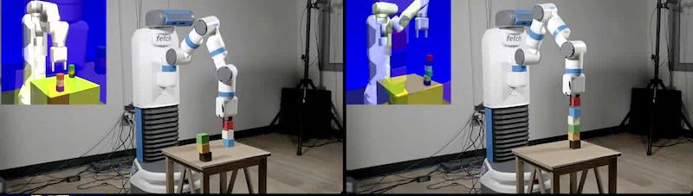
What is URDF?
URDF stands for Unified Robot Description Format
For using a 3D model of a Robot that you are working and simulating with in ROS,it has to be in URDF format only
ROS has libraries/packages installed that parses the URDF files

Slide 3
Two approaches
But in our session we are going to proceed with creating a model from scratch ourselves….. :)
Writing your own URDF files from scratch and create a robot model
Boring,Time consuming
Highly prone to errors which are difficult to identify
You can model your robot in CAD/3D modelling softwares like SolidWorks,Fusion 360,AutoCAD and use external packages /libraries to parse those 3D files

Slide 4
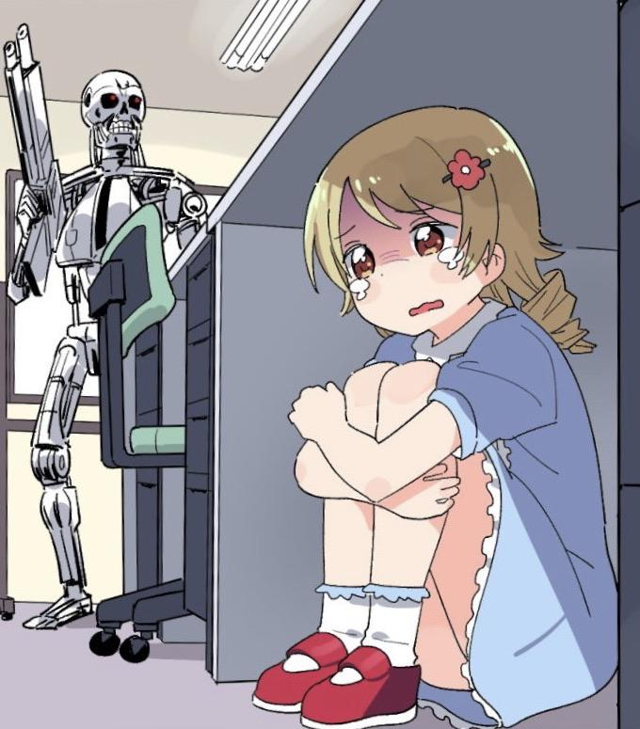
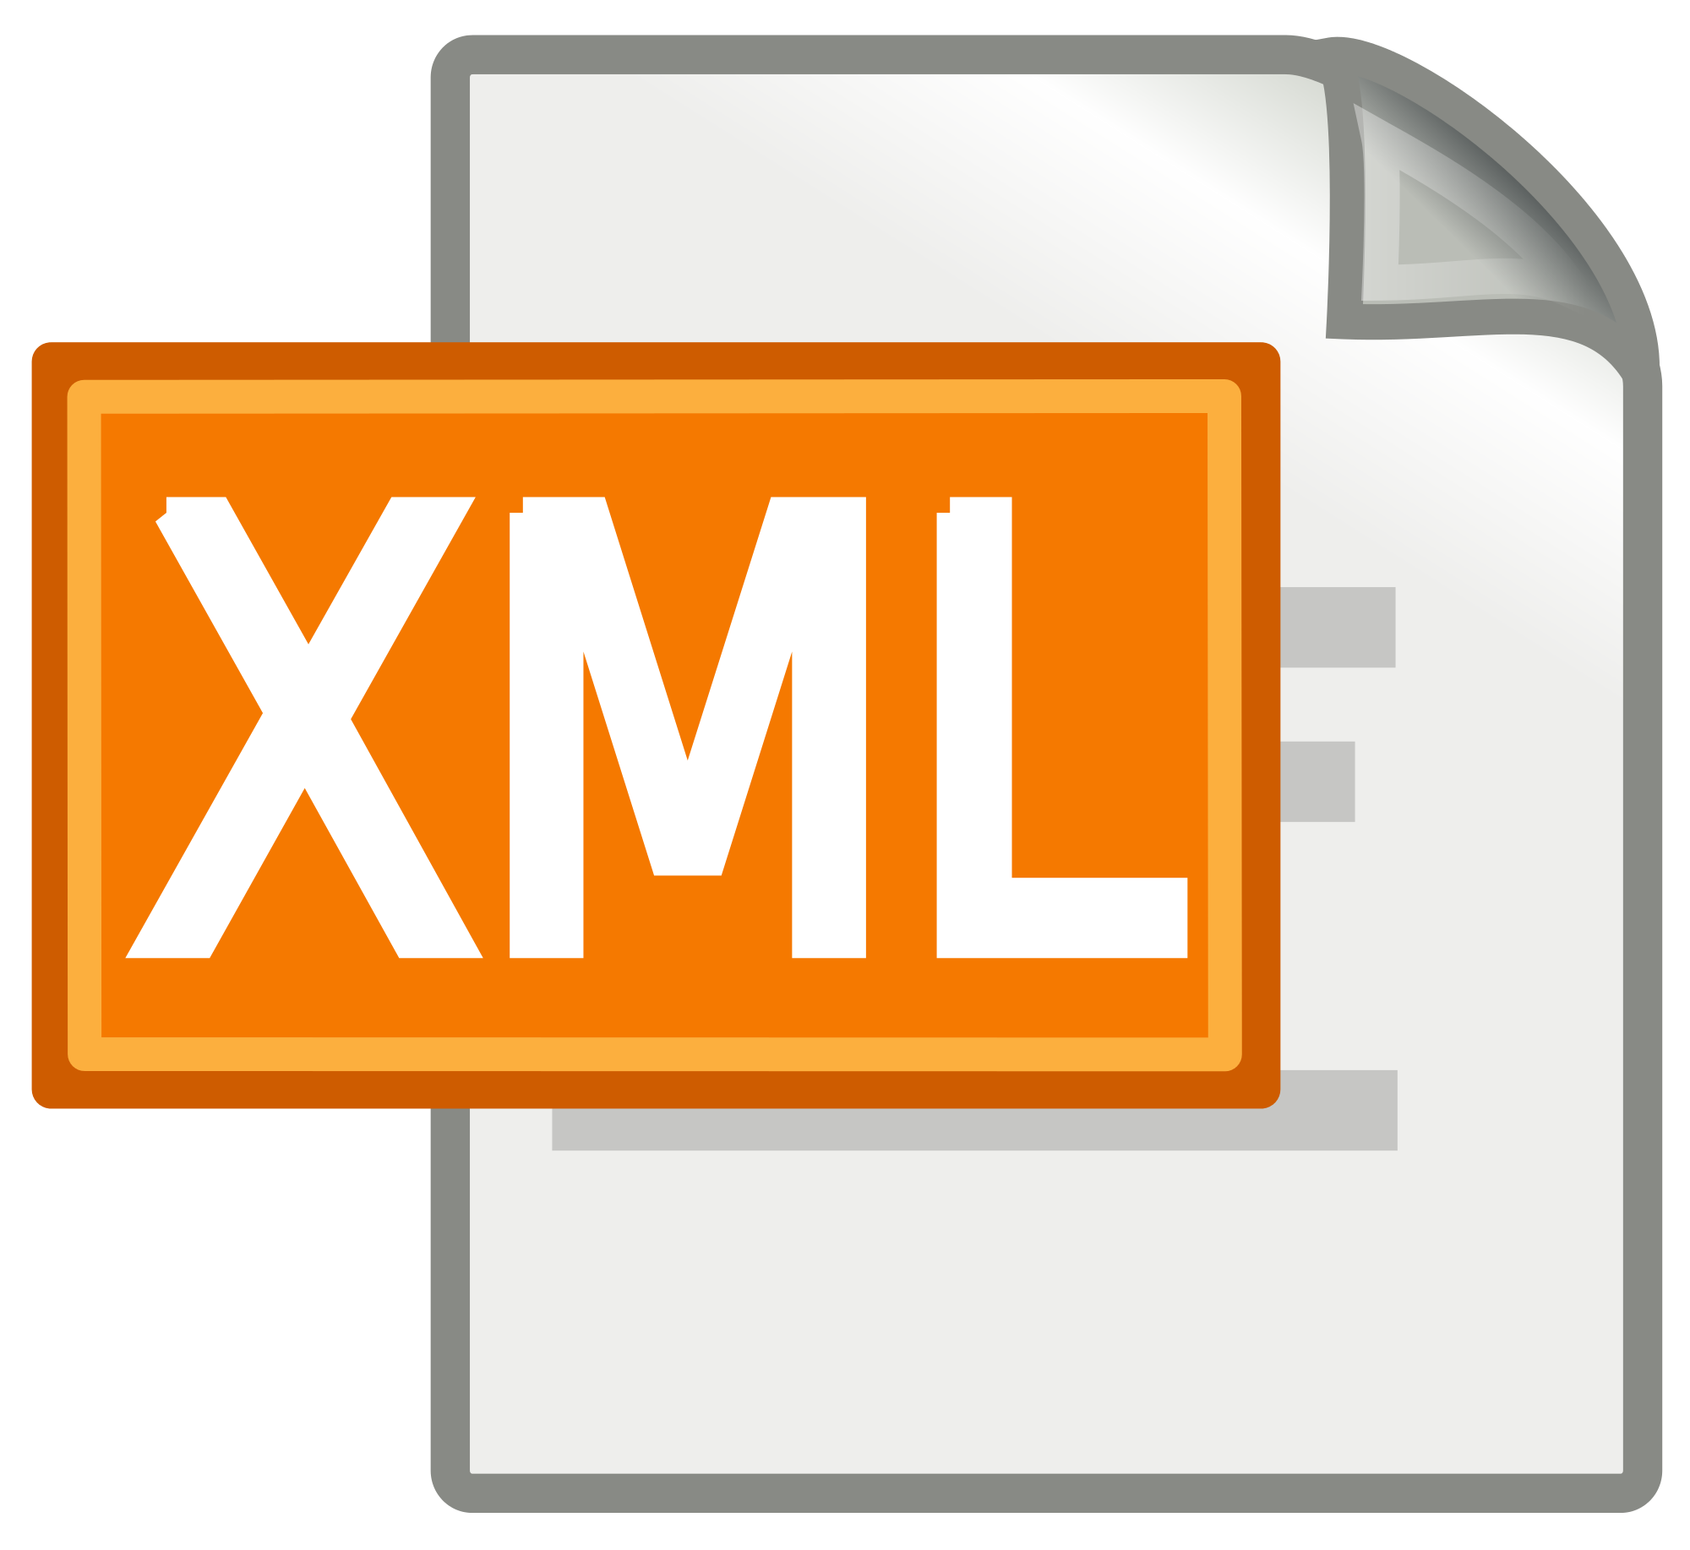
Understanding the XML syntax

Slide 5
<robot>= Root element in desc file(similar to <html> tag)
<gazebo>= Element used to describe simulation properties
<sensor> = Used for inclusion of sensors like cameras,laser,etc
<material> = To describe the material properties like color,texture,etc
And many more…….
<geometry> ,<inertial> ,<collision> ,<cylinder> ,<box>

Slide 6
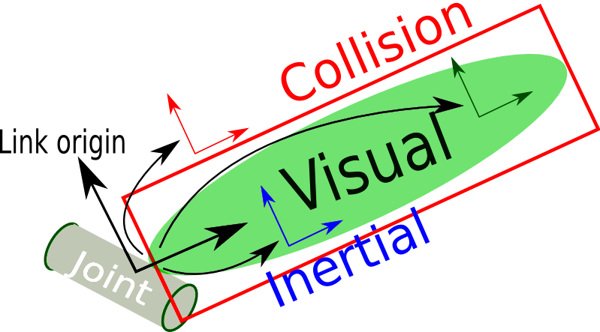
<link>
This element describes a rigid body with inertia,visual features and collision properties

Slide 7
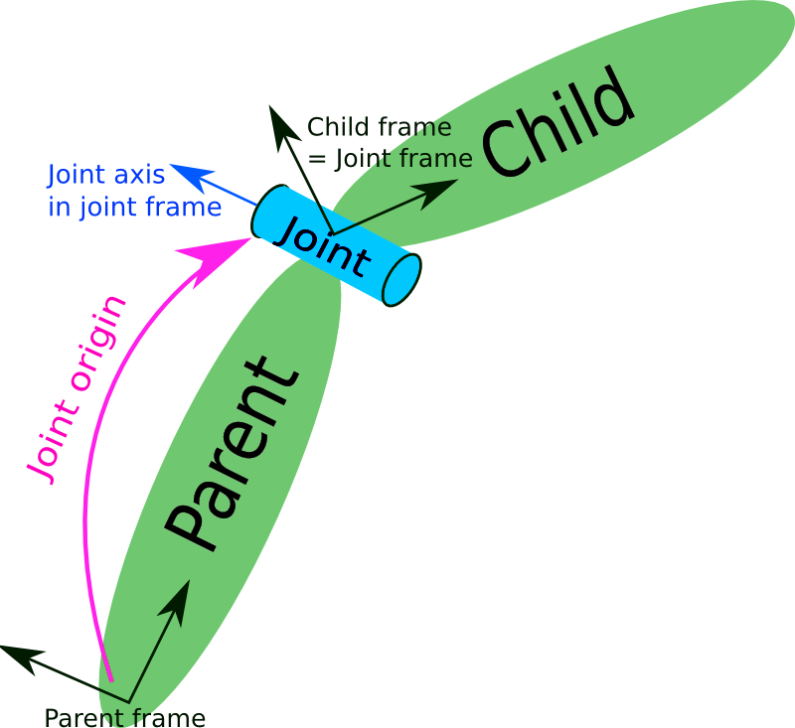
<joint>
This element describes a kinematics and dynamics of a joint and also specifies the safety limits of it

Slide 8
Time to proceed with coding…

Slide 9
Simultaneous Localisation and Mapping(SLAM)
Consider a home robot vacuum
Without SLAM:
Moves randomly and will not be able to cover entire home
Excessive power usage
Too much time
With SLAM
Use infos such as no of wheel revolutions ,datas from sensor to determine the amount of movement
Process also called as Localisation
Using the sensors robot can create a map of obstacle in its surroundings and avoid the clean area twice
Process also called as mapping
Both the mapping and localisation takes place simultaneously and thus the name

Slide 10
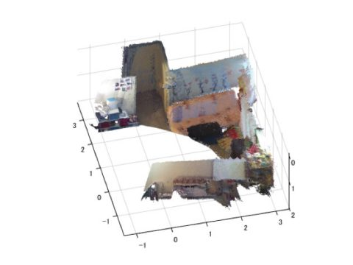
Two types of SLAM:Visual and LiDAR
Visual slam:
Makes use of image acquired from cameras and image sensors
Different types of camera can be used such as Monocular,Stereo,Depth cameras
Algorithms can be classified into two categories
Sparse Method: Matches feature points of images
Dense Method: Overall Brightness of Images

Slide 11
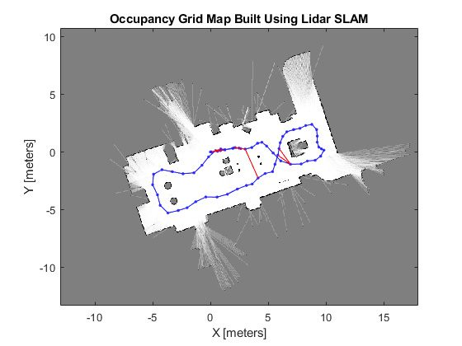
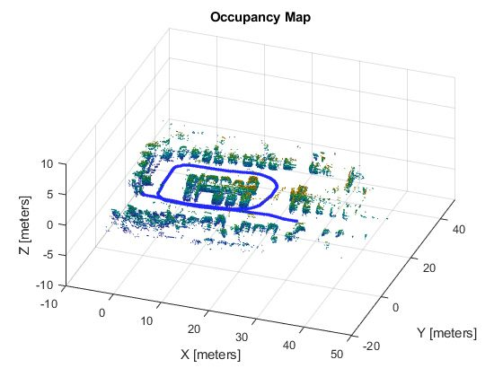
Two types of SLAM:Visual and LiDAR
LiDAR slam:
Abbreviates to Light detection and ranging,primarily uses a laser sensor
Output values from laser sensors are generally 2D or 3D point cloud data
Laser sensor point cloud provides high precision distance measurements and works effectively for map construction with SLAM

Slide 12
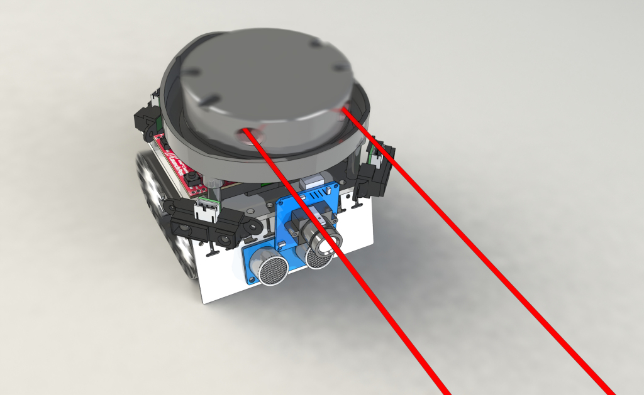
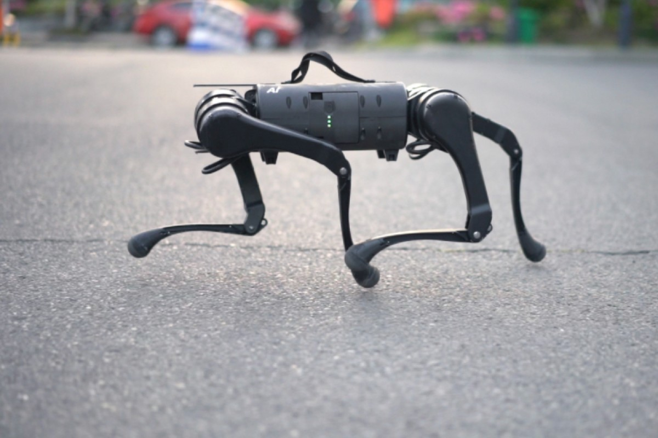
Lets see SLAM in action on a quadruped robot

